Slide 1

Banking Marketing Campaign
Feature Importance
Modelling
Contact
EDA
Conclusion
Feature Correlation
Day
Education
Jobs
Balance
Age
Recommendations
Model Evaluation
Default Housing Loan
Duration
Month
Marital Status
Introduction
The goal is to predict which
people will sign up for a saving account

Slide 2
Marketing campaigns are characterized by focusing on the customer needs and their overall satisfaction.
The goal of this project is to use the data to develop a strong model in order to predict which people the bank should target for their marketing campaign to get people to sign up for a saving account.
In general, datasets which contain marketing data can be used for 2 different business goals:
Prediction of the results of the marketing campaign for each customer and clarification of factors which affect the campaign results. This helps to find out the ways how to make marketing campaigns more efficient.
Finding out customer segments, using data for customers, who will subscribe to the saving deposit. This helps to identify the profile of a customer, who is more likely to acquire the product and develop more targeted marketing campaigns.
Modelling
Month
EDA
Education
Day
Age
Conclusion
Balance
Jobs
Introduction
Duration
Marital Status
Model Evaluation
Contact
Recommendations
Feature Correlation
Feature Importance
Default Housing Loan

Slide 3
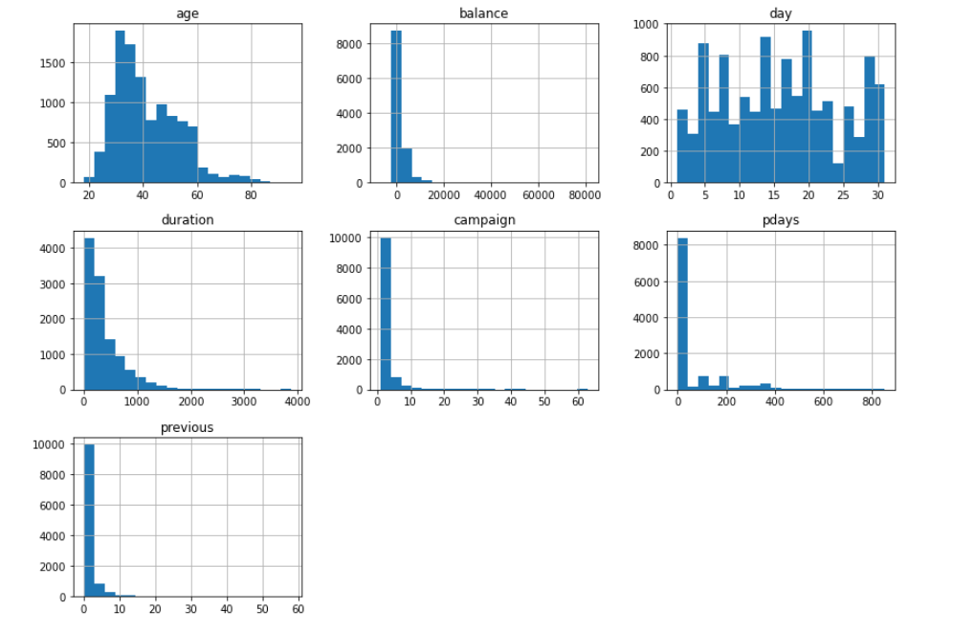
Some feature insights can be seen from the below histograms
Modelling
Contact
EDA
Month
Education
Day
Age
Conclusion
Balance
Jobs
Introduction
Model Evaluation
Duration
Marital Status
Recommendations
Feature Correlation
Feature Importance
Default Housing Loan
These are a general overview of some visual analysis. From the next slide, there will be displayed more detailed visual charts of different features.

Slide 4
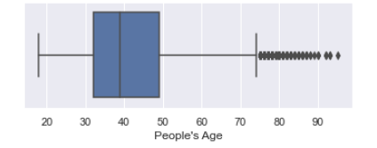
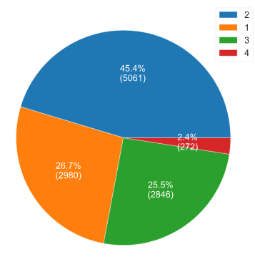
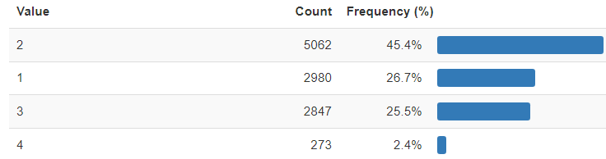
From the boxplot below you can see how the age data is distributed.
Then, we found that:
Ages above 74.5 are outliers
There are 171 outliers
From this age analyse we cannot conclude that the age of people has high effect whether they will deposit money or not. People of any age could open the account that's why we can fit our model with and without these outliers.
Modelling
Contact
EDA
Month
Age
Day
Education
Conclusion
Balance
Jobs
Introduction
Model Evaluation
Duration
Marital Status
Recommendations
Feature Correlation
Feature Importance
Default Housing Loan
Age 0 <= 32 is the 1 category
Age 32 <= 47 is the 2 category
Age 47 <= 70 is the 2 category
Age 70 <= 98 is the 2 category

Slide 5
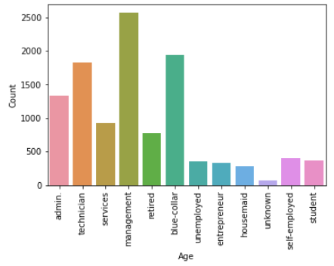
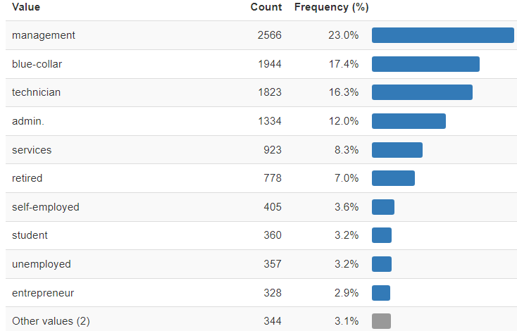
Here can be seen the ratio of the customer’s roles
The majority of customers have management positions and blue-collar jobs.
Modelling
Contact
EDA
Day
Month
Education
Age
Conclusion
Balance
Jobs
Model Evaluation
Duration
Marital Status
Introduction
Recommendations
Feature Correlation
Feature Importance
Default Housing Loan

Slide 6
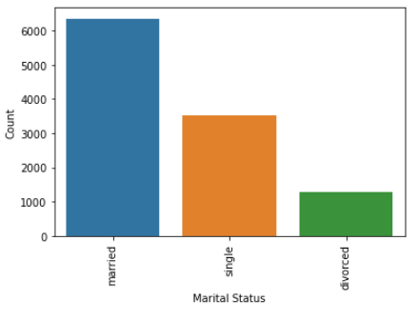
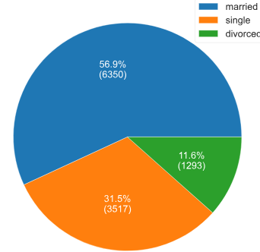
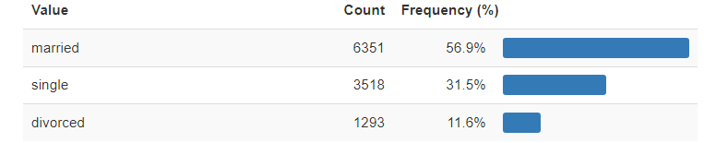
The majority of customers are married which accounts around 57%.
Modelling
Contact
EDA
Month
Day
Education
Age
Conclusion
Balance
Jobs
Model Evaluation
Duration
Marital Status
Introduction
Recommendations
Feature Correlation
Feature Importance
Default Housing Loan

Slide 7
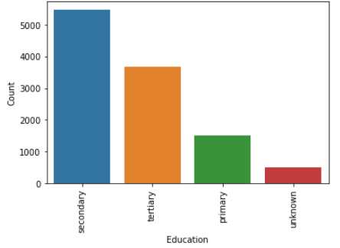
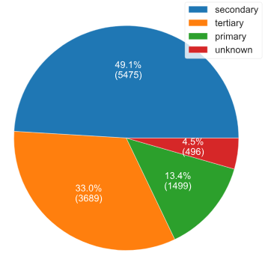
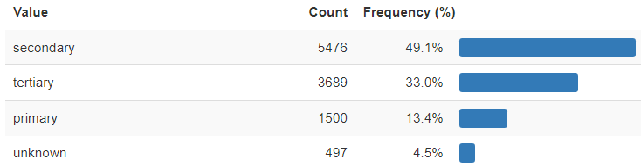
Nearly half of the clients have secondary education.
Modelling
Contact
secondary 5476
tertiary 3689
primary 1500
unknown 497
EDA
Day
Month
Age
Conclusion
Balance
Jobs
Introduction
Education
Model Evaluation
Duration
Marital Status
Recommendations
Feature Correlation
Feature Importance
Default Housing Loan

Slide 8
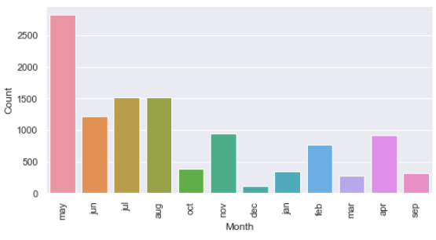
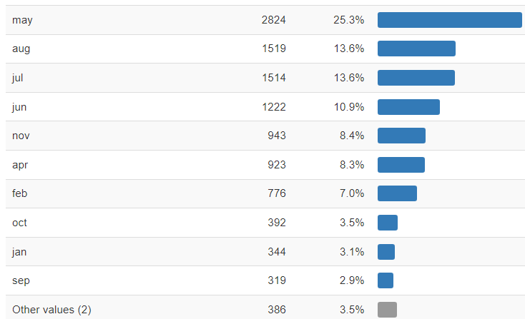
The month where customers were mostly contacted is May with about 25%
May 2824
Aug 1519
Jul 1514
Jun 1222
Nov 943
Apr 923
Feb 776
Oct 392
Jan 344
Sep 319
Mar 276
Dec 110
Modelling
Contact
Month
EDA
Education
Day
Age
Conclusion
Balance
Jobs
Model Evaluation
Duration
Marital Status
Introduction
Recommendations
Feature Correlation
Feature Importance
Default Housing Loan

Slide 9
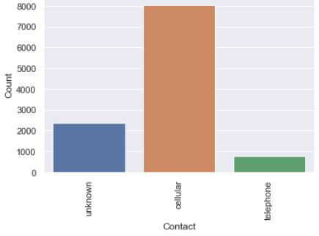
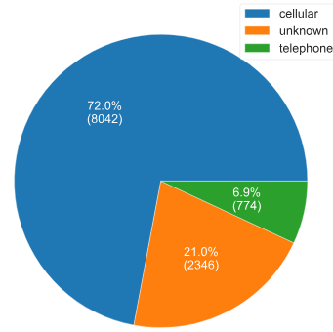
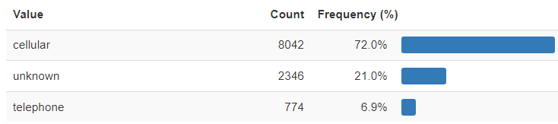
Modelling
Contact
EDA
Month
Education
Day
Age
Conclusion
Balance
Jobs
Model Evaluation
Duration
Marital Status
Introduction
Recommendations
Feature Correlation
Feature Importance
Default Housing Loan
From these charts we can see that 72% or 8042 of all people were contacted by cellular numbers.

Slide 10
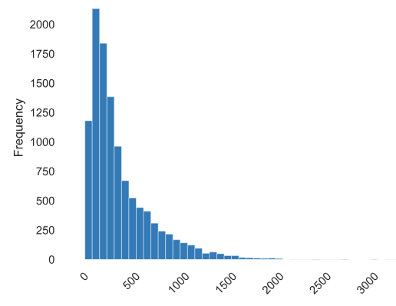
Duration of calls are in seconds.
Modelling
Contact
EDA
Month
Education
Day
Age
Conclusion
Balance
Jobs
Model Evaluation
Duration
Marital Status
Introduction
Recommendations
Feature Correlation
Feature Importance
Default Housing Loan

Slide 11
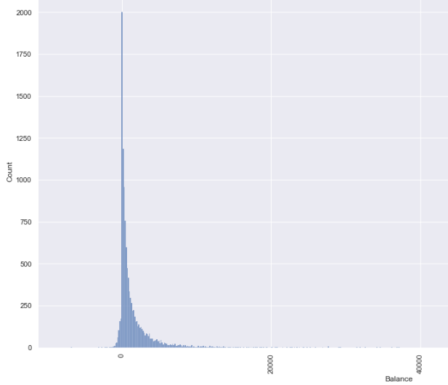
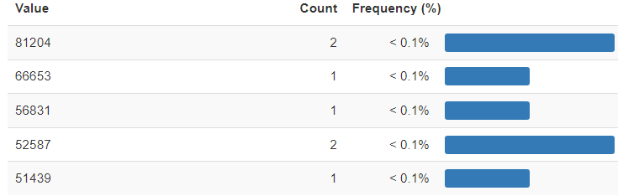
There are a few accounts that have minus balances.
Value Count Frequency (%)
-6847 1 < 0.1%
-3058 1 < 0.1%
-2712 1 < 0.1%
-2282 1 < 0.1%
-2049 1 < 0.1%
Modelling
Contact
EDA
Month
Education
Day
Age
Conclusion
Jobs
Balance
Marital Status
Introduction
Model Evaluation
Duration
Recommendations
Feature Correlation
Feature Importance
Default Housing Loan

Slide 12
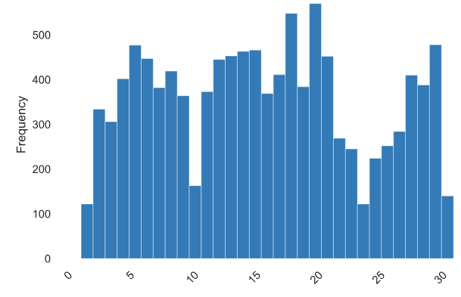
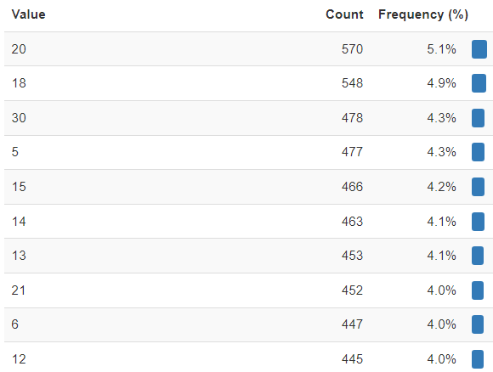
An interesting insight here is that many customers were contacted on 20th and 18th dates of months.
Modelling
Contact
EDA
Month
Education
Day
Age
Conclusion
Jobs
Balance
Marital Status
Introduction
Model Evaluation
Duration
Recommendations
Feature Correlation
Feature Importance
Default Housing Loan

Slide 13
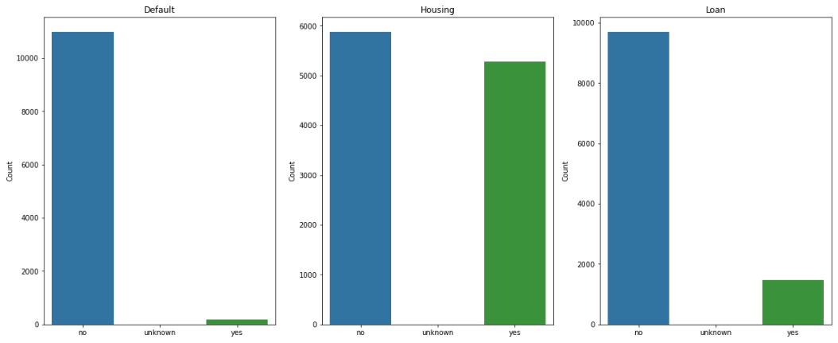



Defining has a credit in default, and house and personal loans or not.
Modelling
Contact
EDA
Month
Education
Day
Age
Conclusion
Jobs
Balance
Marital Status
Introduction
Model Evaluation
Duration
Recommendations
Feature Correlation
Feature Importance
Default Housing Loan

Slide 14
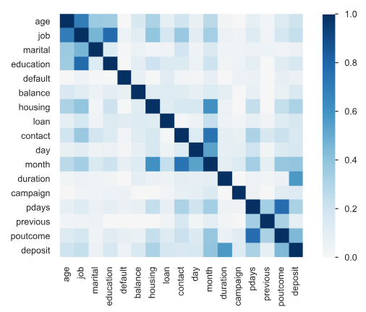
Feature Correlation heatmap
Here can be seen the following good correlations between:
poutcome and deposit
poutocome and pdays
marital status and job
age and education
month and housing
month and contact
duration and deposit
age and job
month and day
Modelling
Contact
EDA
Month
Education
Day
Age
Conclusion
Jobs
Balance
Marital Status
Introduction
Model Evaluation
Duration
Recommendations
Feature Correlation
Feature Importance
Default Housing Loan
This heatmap is a great way of displaying how features are well correlated with one another.

Slide 15
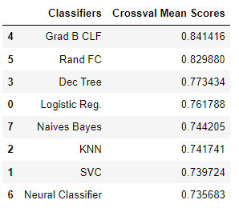
After building several different models and validating them with cross validating scores, we have the models with the scoring results sorted by descending order. The best performing model (by accuracy score) below:
Modelling
Contact
EDA
Conclusion
Month
Education
Day
Age
Jobs
Balance
Marital Status
Introduction
Model Evaluation
Duration
Recommendations
Feature Correlation
Feature Importance
Default Housing Loan
As can be seen from the above table, the best performing model in terms of accuracy score is Gradient Boosting, followed by Random Forest model.
These two ones are by far in front of others.

Slide 16
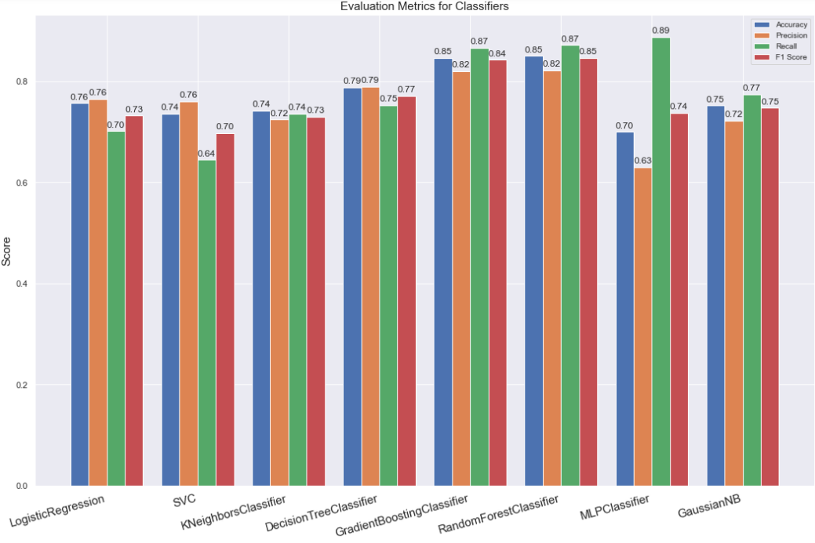
Modelling
Contact
EDA
Month
Education
Day
Age
Conclusion
Jobs
Balance
Marital Status
Introduction
Recommendations
Model Evaluation
Duration
Feature Importance
Feature Correlation
Default Housing Loan
We want to see each classifier’s name in the chart to see the best performing model in terms of the accuracy precision, recall, and f1 scores.
We will predict our ‘y’ variable( y = deposit) through the models we built and see the results.
The detailed result of the best performing model can be seen the above chart.
The other interested insight here is that MLP Classifier has the best f1 score.

Slide 17
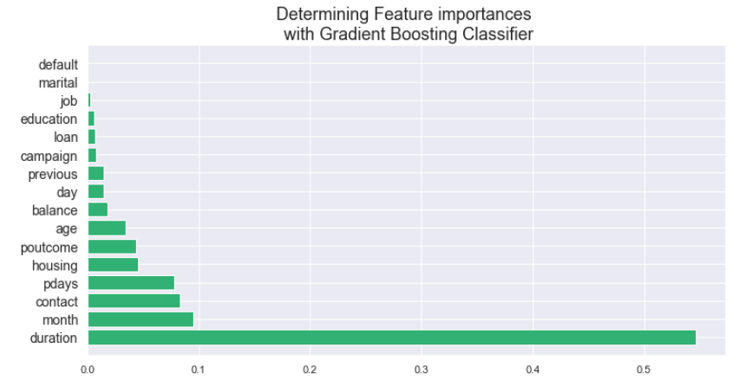
This chart displays importance of features of the data.
As can be seen the most important feature is Duration.
We choose Gradient Boosting Classifier as it showed the best result in terms of accuracy score.
Modelling
Contact
EDA
Month
Education
Day
Age
Conclusion
Jobs
Balance
Marital Status
Introduction
Recommendations
Model Evaluation
Duration
Feature Correlation
Feature Importance
Default Housing Loan

Slide 18
Months of Marketing Activity: We saw that the month of highest level of marketing activity was the month of May. However, this was the month that potential clients tended to reject saving deposits offers.
2)Age: The majority of our customers are in between 32 and 47 years old, which is the 2 category.
3) Jobs: Most of our customer do management and blue-collar jobs.
4) Marital Status: 56.9 % of our clients are married, 31.5 % are single, and 11.6 % of them are divorced.
5) Education: consists of secondary – 5476, tertiary – 3689, primary -1500, unknown - 497
6) Contact: Mostly were contacted by the way of cellular numbers which is 72%, followed by unknown is 21 %, and telephone is 6.9 %.
7) Day: Many customers were contacted on 20th and 18th dates of months.
8) Model performance: the best performing model in terms of accuracy score is Gradient Boosting, followed by Random Forest model, with the accuracy of 84% and 83% respectively.
9)Feature Importance: The important feature is Duration.
Modelling
Contact
EDA
Month
Education
Day
Age
Conclusion
Jobs
Balance
Marital Status
Introduction
Recommendations
Model Evaluation
Duration
Feature Correlation
Feature Importance
Default Housing Loan

Slide 19
Months : For the next campaign, it will be wise for the bank to focus the marketing campaign during the months of March, September, October and December. (because there were the months with the lowest marketing activity, there might be a reason why).
2) Campaign Calls: A policy should be implemented that states that no more than 3 calls should be applied to the same potential client in order to save time and effort in getting new potential clients. Remember, the more we call the same potential client, the likely he or she will decline to open a saving account.
3) Age Category: The next marketing campaign of the bank should target potential clients in their 20s or younger and 60s or older. It will be great if for the next campaign the bank addressed these two categories and therefore, increase the likelihood of more saving accounts to open.
4) Develop a Questionnaire during the Calls: Since duration of the call is the feature that most positively correlates with whether a potential client will open the account or not, by providing an interesting questionnaire for potential clients during the calls the conversation length might increase.
5) Target individuals with a higher duration: Target the target group that is above average in duration, there is a highly likelihood that this target group would open for opening the new account. This would allow that the success rate of the next marketing campaign would be highly successful.
Other recommendations for the bank than can help improve the deposit rate are:
• Listen to the leads and extract more information to deliver the best deposit plan, which can increase the duration of calls and that can lead to a deposit.
• Approaching the leads during the start of new bank period (May-July) will be a good choice as many have shown positive results from data history.
Modelling
Contact
EDA
Month
Education
Day
Age
Conclusion
Jobs
Balance
Marital Status
Introduction
Recommendations
Duration
Model Evaluation
Feature Correlation
Feature Importance
Default Housing Loan

